Slide 1
Oracle Migration demo
Ton Machielsen
Sr. Sales Engineer

Slide 2
EDB Postgres Advanced Server
La clave de las migraciones de Oracle a Postgres.
Oracle Compatibility
EDB Postgres Advanced: Redwood Mode
Advanced SQL
Advanced Security
Advanced Replication
EDB Postgres Advanced: Redwood and Berkeley Mode
Advanced Replication
Transparent Data Encryption
Transparent Data Encryption
PostgreSQL
PostgreSQL
PostgreSQL
Community 360
Standard
Enterprise

Slide 3



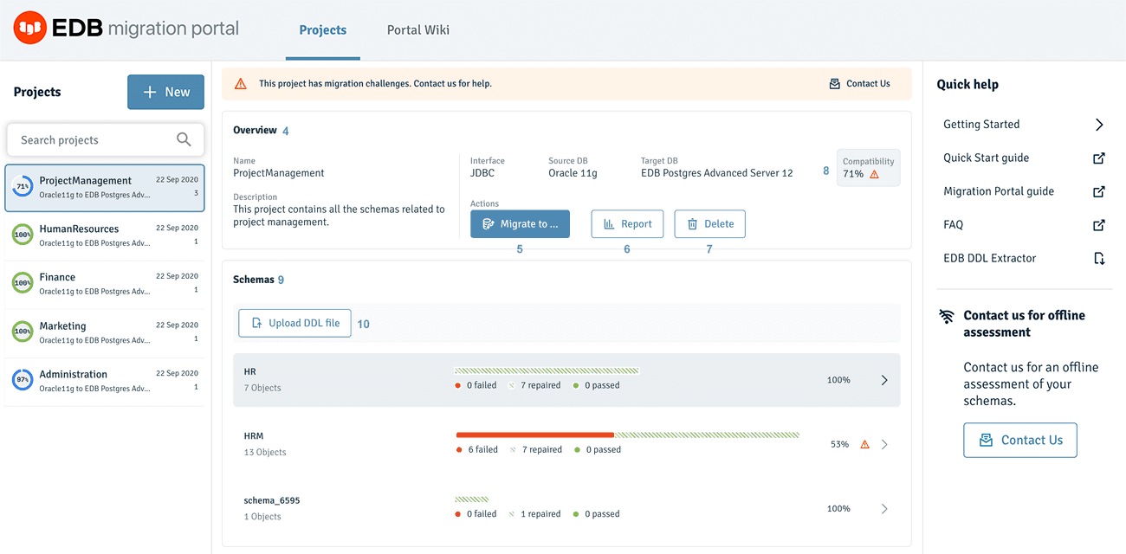

Arquitectura demo

Slide 4
Questions?
Ton Machielsen
ton.machielsen@EDB.com
https://github.com/ToontjeM/oracle-migration-demo

